Slide 1

Coding a Simple Program Evaluation and Review Technique
Matthew Wirasakti
CS 315-001
December 1st, 2020

Slide 2
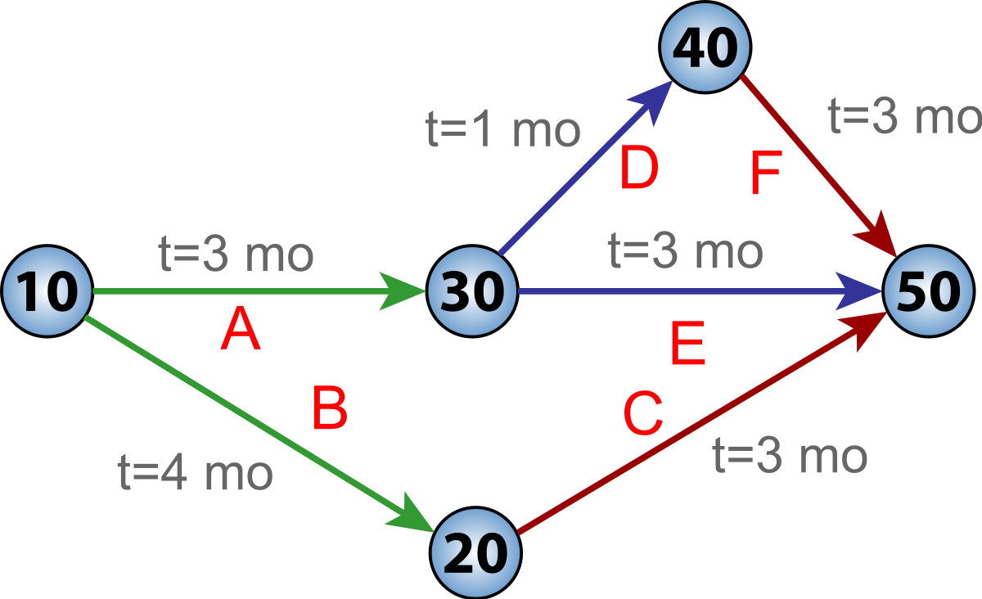
Abstract
The Program Evaluation and Review Technique, also know as PERT, is a method used in project managements to plan out projects. Each step in a project is listed as an event and each event has its own descriptors, such as duration and whether it is a successor or predecessor.
The main use of PERT is to determine the shortest time, or longest time, it would take to complete a proposed project.

Slide 3
Problem
The problem is that planning out a project using PERT can take a long time, especially for large-scale projects, and the calculations needed do not fare well for small-scale projects.
Additionally, without the use of a program, it would take even more effort to determine the shortest amount and longest amount of time a project could take.

Slide 4
Importance of the Problem
Project management is common in many areas besides Computer Science and Engineering. Project management is key in many different sectors, especially since it focuses on leading a team to complete a variety of projects in a specified amount of time. That is why the use of planning methods, like PERT, are important in order for teams to properly space out assignments and activities to complete a project.

Slide 5
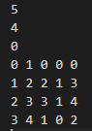
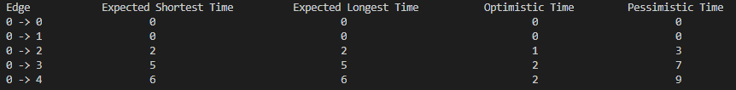
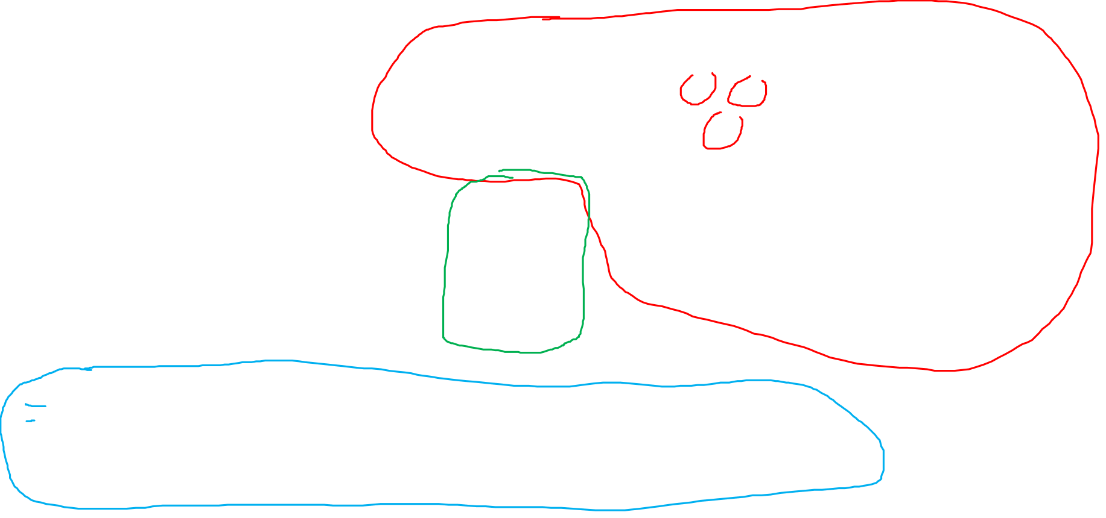
Example 1
Start
E: 2 O: 1 P: 3
E: 1 O: 0 P: 2
Finish
E: 3 O: 1 P: 4
An example like the one on the right shows a simple project, with each box representing an event and containing the time it would take to complete it, that could be inputted into the program.
Also, on the right is the input to the program.
Below is the generated output showing times from the start to each event.

Slide 6
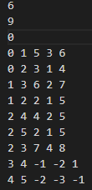
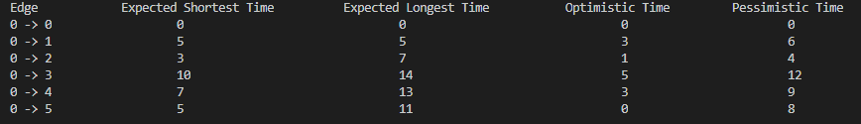
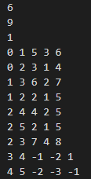
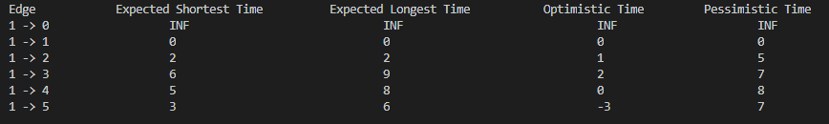

Example 2
The examples on the right show two complicated but similar projects, the difference being the starting event

Slide 7
Solutions and Algorithms
A project and its predecessor and successor events essentially form a Directed Acyclic Graph. The solution was to make a program that could take an input of events and their descriptors, and then topologically sort the events to list out the events in order from least amount of predecessors to most. After, the program would take the given starting event and then calculate the length of time it would take to get to every other event, shortest and longest.
The algorithms used would be a topological sort which then leads to the algorithm going through each vertex (event) to calculate the distance (length of time – both shortest and longest)

Slide 8
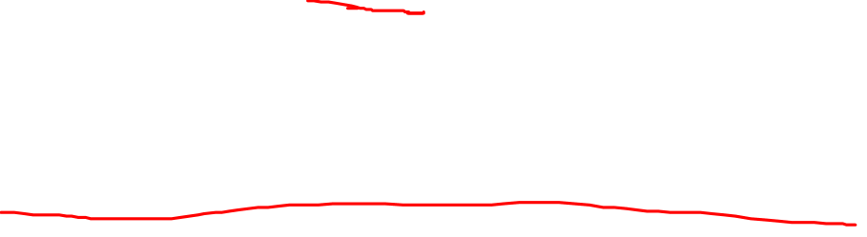
Complexity and Interesting Points
Using a topological sort on a Directed Acyclic Graph allows for the complexity of the program to be 0(V + E). One of the interesting parts of this program is how the output generated lists each of the events in the topological order it was sorted, which allows the user to have a consistent understanding of the project timeline. Another interesting part is how all three different times were calculated – pessimistic, optimistic, and expected time.

Slide 9
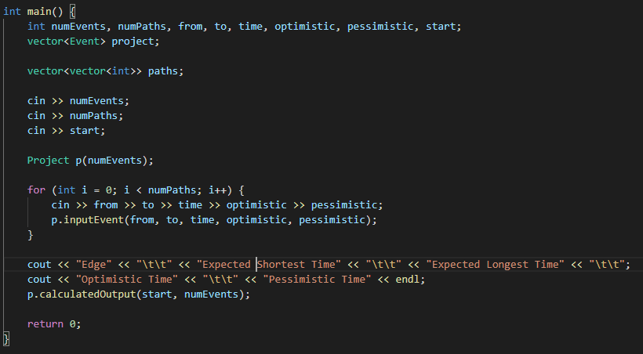

Implementation
The majority of the implementation focuses on making two classes: one for the events and one of the entire project, each with their own functions
The added value to this program is the ability for the user to choose which event will be the starting event, allowing the outputs to adapt to a team’s needs

Slide 10
Conclusion
Overall, the program does well in computing and outputting different time measurements depending on the category
In terms of future work, adding in an element to calculate early and late starts and finishes would allow for a more descriptive output that would be even more beneficial for the user and the team working on the project. Additionally, one could look at the M-PERT and see how it fixes some problems lying in PERT calculations.

Slide 11

References
Ballesteros-Pérez, P. (2017). M-PERT: Manual Project- Duration Estimation Technique for Teaching Scheduling Basics. Journal of Construction Engineering and Management, 143(9), 04017063. doi:10.1061/(asce)co.1943- 7862.0001358
Hoffer, J. Ralph., National Conference on Social Welfare. (1971). A programmed introduction to PERT: program evaluation and review technique for planning large projects in social welfare. Columbus, Ohio: National Conference on Social Welfare.
Program evaluation and review technique. (2020, November 12). Retrieved December 03, 2020, from https://en.wikipedia.org/wiki/Program_evaluation_a nd_review_technique

